Slide 1




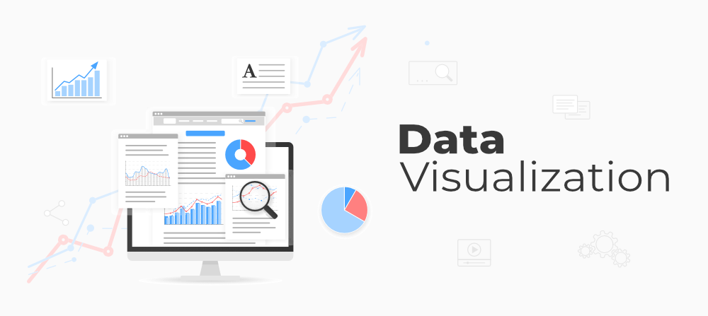
Data
Storage
Transformation
SQL Analytics
Visualisation

Slide 2
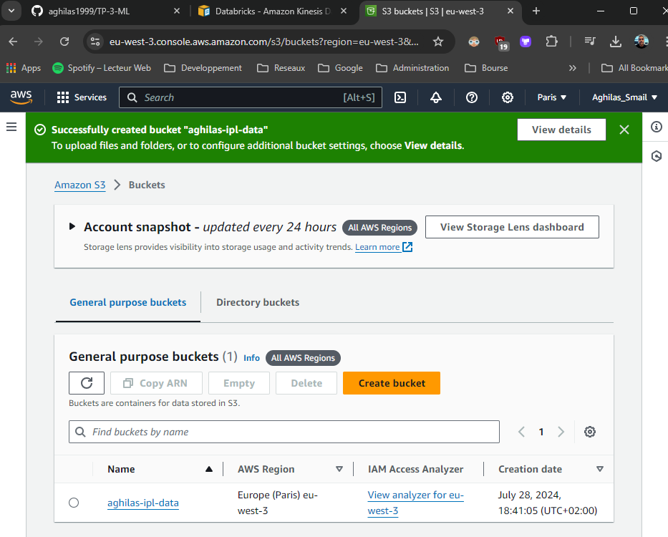
Buckets S3 | aghilas-ipl-data
Link to access to the bucket :🔗

Slide 3
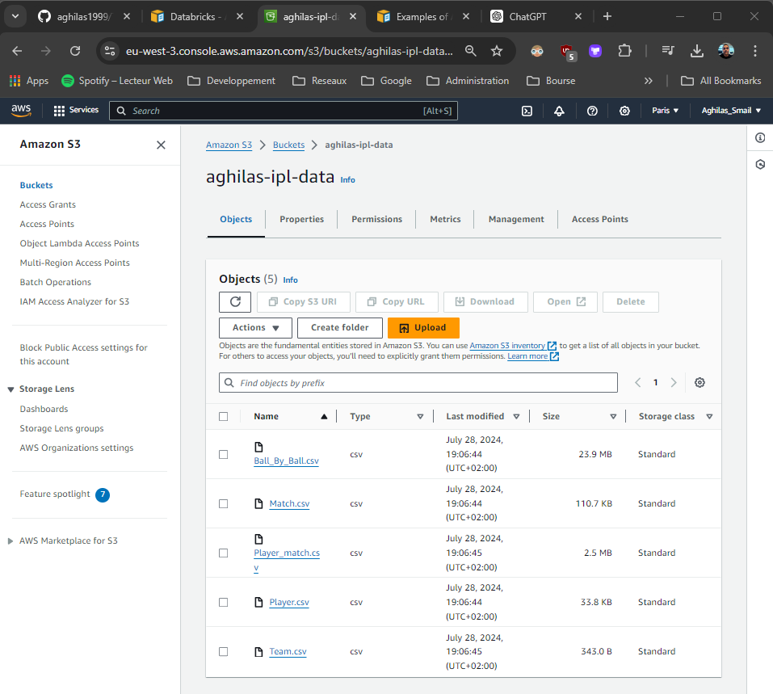
Management of the S3 buckets
Make sure to put the bucket public.
Edit the json file :
{
"Version": "2012-10-17",
"Statement": [
{
"Sid": "PublicRead",
"Effect": "Allow",
"Principal": "*",
"Action": [
"s3:GetObject",
"s3:GetObjectVersion"
],
"Resource": "arn:aws:s3:::aghilas-ipl-data/*"
}
]
}

Slide 4
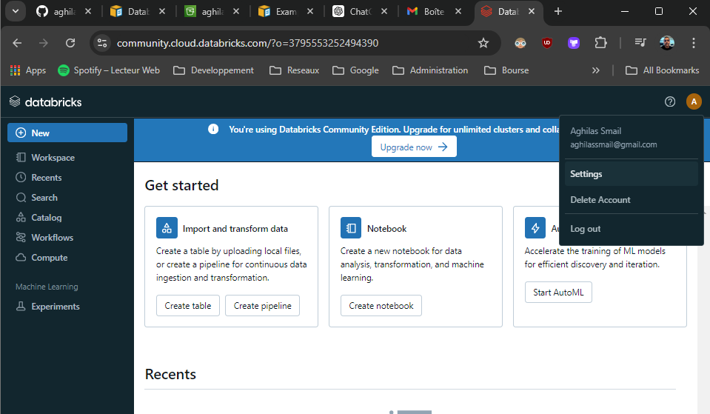
Community edition accound (dataBricks)

Slide 5
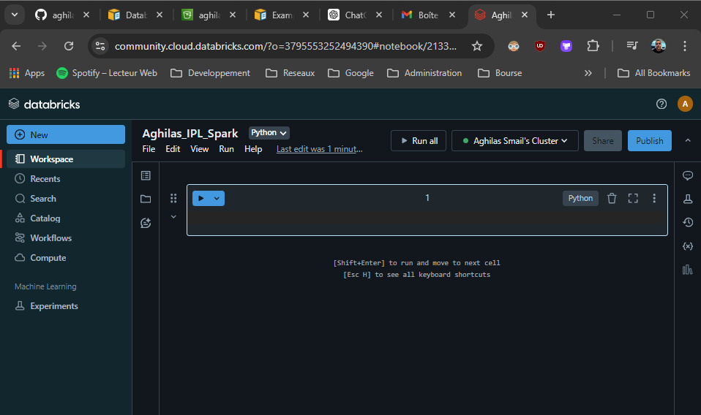
Configuration the databrikcs account
Create new notebook
Create a computer (librairie of spark …)
Choose the the computer

